Slide 1
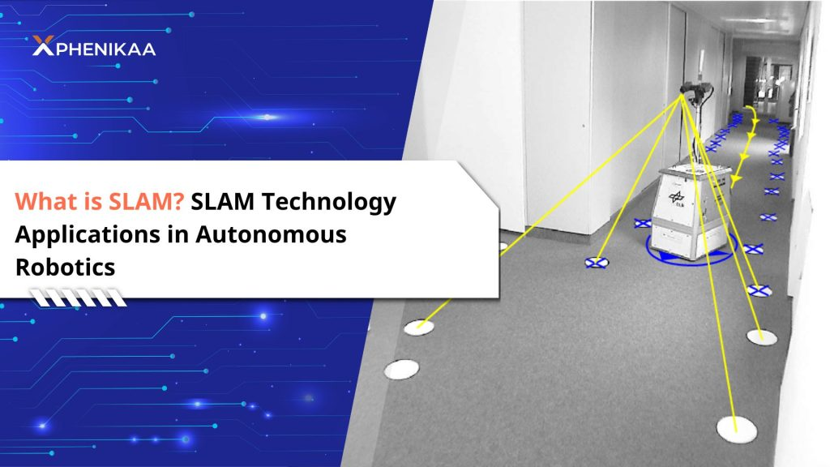

Slide 2
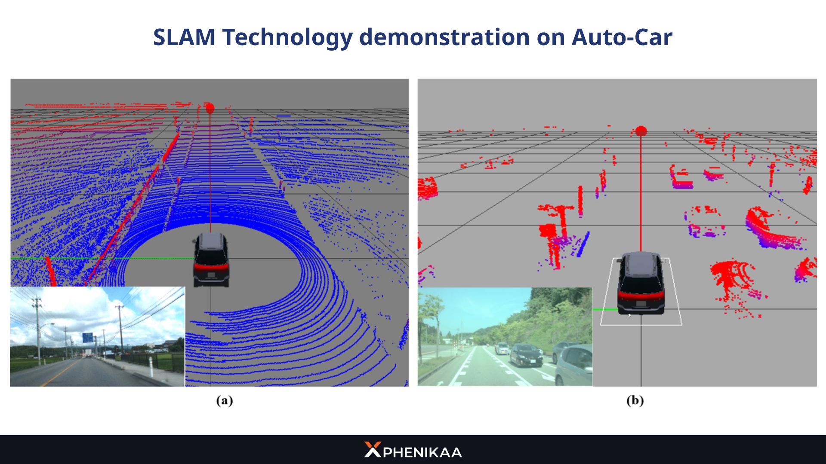

Slide 4
Comparison of Monocular, Stereo, and RGB-D Sensors for SLAM Applications

Slide 5
Learning Objectives
Understand visual sensors used in SLAM
Explain Monocular, Stereo, and RGB-D camera principles
Compare their characteristics and suitability for SLAM
Relate sensor selection to ORB-SLAM performance

Slide 6
Introduction to Visual SLAM
SLAM: Simultaneous Localization and Mapping
Uses visual data to estimate camera pose and build maps
Visual SLAM = feature extraction + motion estimation + loop closure
ORB-SLAM: feature-based approach using ORB (Oriented FAST and Rotated BRIEF) algorithm

Slide 7
ORB-SLAM Overview
The system's entire visual processing is based on ORB features, which are corners in an image that are both rotation- and scale-invariant.
FAST (Features from Accelerated Segment Test) corners: The algorithm identifies high-contrast pixels in a circular pattern to quickly locate corners.
Rotated BRIEF (Binary Robust Independent Elementary Features) descriptors: A 256-bit binary descriptor is generated for each corner to describe the patch of pixels around it. This is made rotation-invariant by factoring in the corner's orientation.
Three main threads: Tracking, Local Mapping, Loop Closing
Uses keyframes and map points for optimization
Supports Monocular, Stereo, and RGB-D modes
Accurate, robust, and open-source (Mur-Artal et al., 2015)

Slide 8
Classification of Visual Sensors
Monocular camera: single lens, 2D intensity data only
Stereo camera: two cameras with known baseline for triangulation
RGB-D camera: active sensing using IR/ToF to obtain depth map

Slide 9
Monocular Cameras
Single camera, captures 2D images
No direct depth → scale ambiguity
Low cost, low power, lightweight
Requires motion for structure-from-motion (SfM)
ORB-SLAM (monocular) estimates depth via motion cues
Advantages:
Lightweight and inexpensive.
High resolution, well-supported by SLAM frameworks (e.g., ORB-SLAM, LSD-SLAM).
Limitations:
Scale ambiguity (depth only relative).
Poor performance in low-texture or low-light environments.
Requires motion for depth recovery.
SLAM suitability:
Good for lightweight mobile robots, drones.
Not ideal where accurate metric scale is needed.

Slide 10
Stereo Cameras
Two cameras with a known baseline.
Depth from disparity (triangulation principle).
Advantages:
Provides metric depth directly.
Robust to moderate lighting variation.
Works outdoors (unlike many RGB-D sensors).
Limitations:
Depth accuracy depends on baseline and calibration.
Sensitive to textureless regions.
Higher computation (disparity matching).
SLAM suitability:
Reliable for outdoor navigation, mobile robots, and autonomous vehicles.
Computationally heavier than monocular; baseline limits compactness.

Slide 11
RGB-D Cameras
Provide both color (RGB) and depth (D) using structured light or ToF (Time-of-Flight). (1.https://www.youtube.com/watch?v=bRkUGqsz6SI&t=197s &
2. https://www.youtube.com/watch?v=DHM4moDOYTM&t=17s)
Popular examples: Kinect, RealSense, ZED 2i.
Advantages:
Direct per-pixel depth (no triangulation needed).
Dense 3D map reconstruction possible.
Useful in low-texture indoor environments.
Limitations:
Limited range (typically 0.3 – 5 m).
Sensitive to sunlight (structured light interference).
Higher power consumption.
SLAM suitability:
Excellent for indoor applications (robotic arms, service robots).
Poor outdoor performance.

Slide 12
Comparative Analysis
Feature | Monocular | Stereo | RGB-D
Depth Source | Motion / SfM | Disparity | Active sensing (ToF / IR)
Metric Scale | ✗ | ✓ | ✓
Cost | Low | Moderate | Moderate–High
Range | Long (depends on scene) | Medium–Long | Short (≤5 m)
Lighting Sensitivity | High | Medium | High (sunlight interference)
Computational Load | Low | Medium–High | Medium
SLAM Accuracy | Low–Medium | High | High (indoor)
Example SLAM | ORB-SLAM | Stereo ORB-SLAM | RTAB-Map, KinectFusion

Slide 13
Comparative Analysis
Setup | Estimated motion | Real-world scale? | Remarks
Monocular SLAM | Moves forward 10 “units” | Unknown (could be 10 cm or 10 m) | Relative scale only
Stereo SLAM | Moves forward 1.0 m | Yes | Metric scale available
RGB-D SLAM | Moves forward 1.0 m | Yes | Metric scale from depth data

Slide 14
Suitability for SLAM Applications
Monocular → drones, lightweight robots, academic research
Stereo → autonomous vehicles, outdoor mapping
RGB-D → indoor robots, service robots, manipulation tasks
Hybrid (Visual-Inertial / Multi-sensor fusion) improves robustness

Slide 15
Example ORB-SLAM Implementations
ORB-SLAM (Monocular): real-time feature-based mapping
ORB-SLAM2: supports Monocular, Stereo, RGB-D (https://medium.com/@suvasism/orb-slam-2-under-the-hood-ad120049eff2)
ORB-SLAM3: includes inertial sensor fusion (Visual-Inertial SLAM)
Demonstrated on drones, AR, and autonomous navigation

Slide 16
Choosing the Right Sensor
Consider environment (indoor/outdoor)
Depth accuracy vs. cost vs. range
Lighting conditions and texture
Computational capability of platform
Fusion (IMU, LiDAR) can compensate sensor weaknesses

Slide 17
Summary
Monocular: low cost, no depth → suitable for scale-agnostic SLAM
Stereo: direct metric depth, robust outdoors
RGB-D: dense indoor mapping, limited range
ORB-SLAM supports all three with variant optimizations

Slide 18
References
Mur-Artal et al., 'ORB-SLAM: A Versatile and Accurate Monocular SLAM System,' IEEE T-RO, 2015
Cadena et al., 'Past, Present, and Future of SLAM,' IEEE T-RO, 2016
RTAB-Map and RealSense technical documentation

